Slide 1
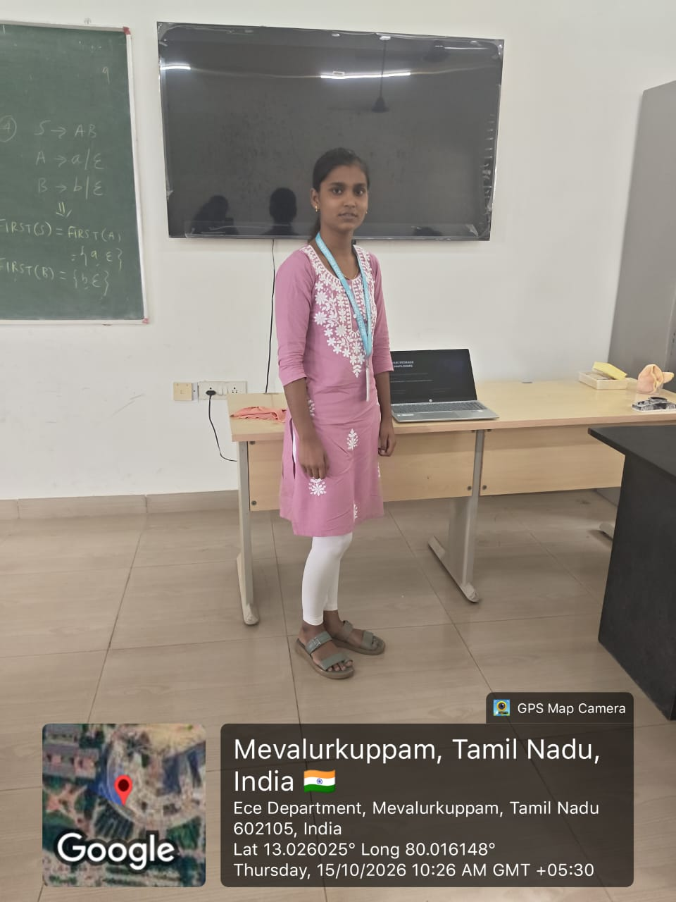

Slide 2
CLOUD STORAGE
TECHNOLOGIES
Object, Block, and File Storage Compared
Technical Presentation | Cloud Computing and Big Data Analytics
Presented by: Nevitha M
Reg No:192521206
Guided by :Dr. Boomija M D
SIMATS ENGINEERING
1

Slide 3
1. What is Cloud Storage?
Objective: understand the three common ways data is stored in the cloud.
Simple definition
Why do we use it?
Cloud storage keeps data on remote servers that we access through a network or the internet.
• Access data from different devices
• Scale storage when needed
• Reduce the need to manage physical disks
Three main types
Object storage
Block storage
File storage
Best for photos, videos, backups
Best for databases and virtual machines
Best for shared folders and documents
2

Slide 4
2. Object Storage
Stores each item as an object with data, metadata, and a unique ID.
Simple example
How it works
• Data is stored as separate objects
• Each object has details (metadata)
• Objects are accessed using a unique key
• Works well for very large amounts of unstructured data
photo.jpg
image data
OBJECT
STORAGE
video.mp4
video data
backup.zip
backup data
Example: storing photos in an online photo service.
3

Slide 5
3. Block Storage
Splits data into fixed-size blocks that can be managed separately.
Think of a disk divided into blocks
How it works
• Data is divided into blocks
• Blocks can be read or updated quickly
• Often attached to a virtual server
• Useful when performance matters
Block 1
Block 2
Block 3
Block 4
Block 5
Block 6
Block 7
Block 8
Block 9
Block 10
Block 11
Block 12
Example: the disk used by a cloud virtual machine or database.
4

Slide 6
4. File Storage
Organizes data into folders and files, just like a computer.
Example folder structure
How it works
• Files are stored in folders
• Users browse by file and folder names
• Multiple users can share the same files
• Familiar and easy to understand
📁 Class Documents
📁 Presentations
📄 Cloud-Storage.pptx
📁 Assignments
📄 Homework.docx
5

Slide 7
5. Quick Comparison
Choose the storage type based on how the data will be used.
OBJECT
BLOCK
FILE
Data format: objects
Best for: photos, videos, backups
Main strength: handles huge data collections
Data format: blocks
Best for: databases, virtual machines
Main strength: fast, low-latency access
Data format: files and folders
Best for: shared folders, team documents
Main strength: simple organization and sharing
Remember: Object = items | Block = performance | File = folders
6

Slide 8
6. Basic Cloud Storage Architecture
A simple view of how a user stores and retrieves data.
1
2
3
4
User / App
Internet / API
Cloud Storage
Data Returned
Phone or computer
Sends a request
Stores or finds data
File or result sent back
Practical example
A student uploads a presentation to cloud storage, then opens it later from another device.
7

Slide 9
7. Industry Relevance
Cloud storage supports many everyday services.
Education
Healthcare
Business
Sharing notes, assignments, and lecture recordings
Keeping and sharing medical images and records
Backing up files and supporting team collaboration
Key benefits
Access from many locations
Scale up or down as needed
Support backup and recovery
Reduce local hardware management
8

Slide 10
CONCLUSION
Three storage types — three different purposes
OBJECT
BLOCK
FILE
Photos, videos, backups
Databases, virtual machines
Folders, shared documents
Key takeaway: choose storage based on the data format, speed needs, and how people access it.
Thank you! • Any questions?
9

